Slide 1


Introduction to Computer Science
Reichman University
Lecture 9-2
Efficiency, Searching, Sorting
Notes:
1

Slide 2
Lecture plan
Program efficiency
Searching algorithms
Sorting algorithms
Open computational problems

Slide 3
Lecture plan
Program efficiency:
So far in the course we treated it informally and casually...
From now on we’ll treat it formally and seriously.
Two kinds of program efficiency
Time efficiency: How fast is the program?
Space efficiency: How much memory does it use?

Slide 4
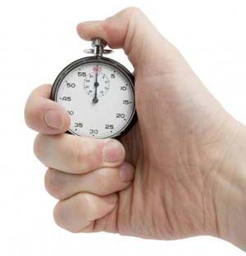

Time efficiency
Two approaches of studying time efficiency
Timing the program
Analyzing the algorithm

Slide 5
Timing program’s efficiency
/** Times the performance of my computer. */
public class TimeMyComputer {
public static void main(String args[]) {
int sum = 0;
double d = 1.618;
BankAccount bobAcct = new BankAccount("bob");
// Starts a timer
Timer timer = new Timer();
// Runs a loop, a billion times
for (int i = 0 ; i < 1000000000 ; i++) {
// Uncomment the operation you wish to time:
// 1. Do nothing
// 2. sum = sum + i;
// 3. d = 1.0 / d;
// 4. bobAcct.deposit(i);
// 5. BankAccount b = new BankAccount("Bla",i);
// 6. Fraction f = new Fraction(i,i+1);
// 7. d = Math.random();
// 8. System.out.println(i);
}
// The loop’s running time, in milliseconds
System.out.println(timer.elapsedTime());
}
}
Timer
A class that helps make time measurements.
(Implementation: later)

Slide 6
Timing program’s efficiency
/** Times the performance of my computer. */
public class TimeMyComputer {
public static void main(String args[]) {
int sum = 0;
double d = 1.618;
BankAccount bobAcct = new BankAccount("bob");
// Starts a timer
Timer timer = new Timer();
// Runs a loop, a billion times
for (int i = 0 ; i < 1000000000 ; i++) {
// Uncomment the operation you wish to time:
// 1. Do nothing
// 2. sum = sum + i;
// 3. d = 1.0 / d;
// 4. bobAcct.deposit(i);
// 5. BankAccount b = new BankAccount("Bla",i);
// 6. Fraction f = new Fraction(i,i+1);
// 7. d = Math.random();
// 8. System.out.println(i);
}
// The loop’s running time, in milliseconds
System.out.println(timer.elapsedTime());
}
}
Shimon’s old PC:
Shimon’s newer PC:
1. 5 ms
2. 389
3. 4898
4. 57
5. 1089
6. 10500
7. 25310
8. 5510222
2 ms
298
3811
47
1088
4741
21526
5443566

Slide 7
Timing program’s efficiency
Limitations
Any one of the following factors impacts the timing results:
Different hardware
Different OS
Different compiler
And more.
Needed: A platform-independent way to measure time efficiency.

Slide 8
Time efficiency
Two approaches of studying time efficiency
Timing the program
Analyzing the algorithm

Slide 9
Running time analysis
Example 1: Searching an array
// Checks if the given array contains the given value
boolean contains(int[] arr, int x) {
for (int i = 0; i < arr.length; i++) {
if (arr[i] == x) {
return true;
}
return false;
}

Slide 10
Running time analysis
Example 1: Searching an array
How many operations are actually executed during run-time?
(Depends on n = arr.length)
// Checks if the given array contains the given value
boolean contains(int[] arr, int x) {
for (int i = 0; i < arr.length; i++) {
if (arr[i] == x) {
return true;
}
return false;
}
c1
c2
c3
c4
c5
Identify and count the program’s operations
c6

Slide 11
Running time analysis
Example 1: Searching an array
How many operations are actually executed during run-time?
(Depends on n = arr.length)
// Checks if the given array contains the given value
boolean contains(int[] arr, int x) {
for (int i = 0; i < arr.length; i++) {
if (arr[i] == x) {
return true;
}
return false;
}
c1
c2
c3
c4
Running time (in this particular problem)
Best case: x is the first element in the array
Worst case: x is not in the array
Average case: x is somewhere in the array
c5
c6
Worst case approach
We always focus on the worst case
When we say “running time”, we mean running time in the worst case
The most conservative, honest approach.

Slide 12
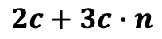
Running time analysis
Example 1: Searching an array
How many operations are actually executed during run-time?
(Depends on n = arr.length)
// Checks if the given array contains the given value
boolean contains(int[] arr, int x) {
for (int i = 0; i < arr.length; i++) {
if (arr[i] == x) {
return true;
}
return false;
}
c1
c2
c3
RunningTime (n) =
c4
c5
$$c1+\left(c2+c3+c4\right)∙n+c6=$$
Assuming that each operation takes more or less the same time, c:
c6
$$2c+3c∙n$$

Slide 13
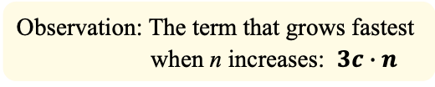
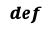
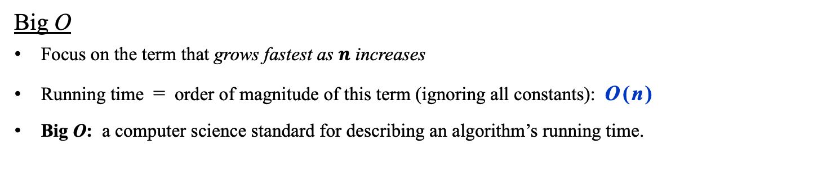
Running time analysis
Example 1: Searching an array
How many operations are actually executed during run-time?
(Depends on n = arr.length)
// Checks if the given array contains the given value
boolean contains(int[] arr, int x) {
for (int i = 0; i < arr.length; i++) {
if (arr[i] == x) {
return true;
}
return false;
}
c1
c2
c3
RunningTime (n) =
c4
c5
$$c1+\left(c2+c3+c4\right)∙n+c6=$$
Assuming that each operation takes more or less the same time, c:
c6
$$2c+3c∙n$$
Observation: The term that grows fastest when n increases: $3c∙n^{}$
Big O
Focus on the term that grows fastest as $n$ increases
Running time = order of magnitude of this term (ignoring all constants): O ( n )
Big O: a computer science standard for describing an algorithm’s running time.
$$def$$

Slide 14
Running time analysis
Example 2: Searching a 2D array
// Checks if a 2D square array contains the given value
Boolean contains(int[][] arr, int x) {
int n = arr.length
for (int i = 0; i < n; i++) {
for (int j = 0 ; j < n ; j++) {
if (a[i][j] == x) {
return true;
}
return false;
}

Slide 15
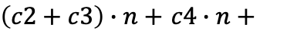
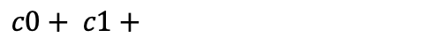
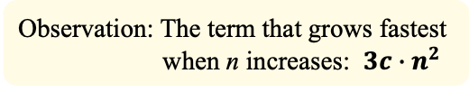
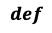
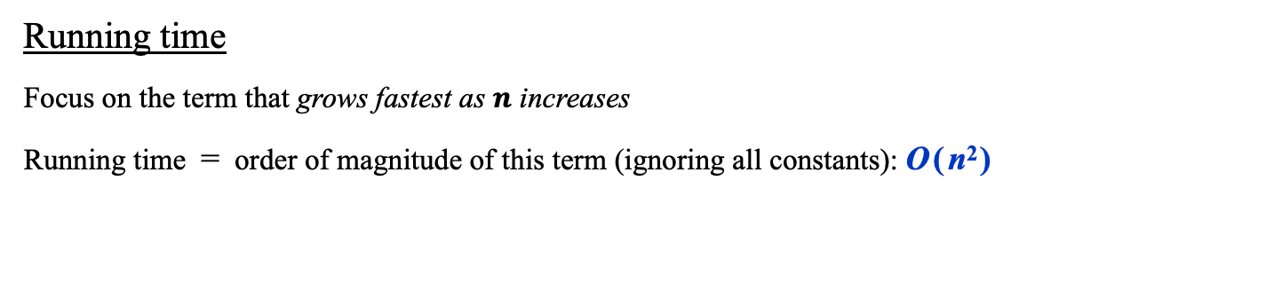
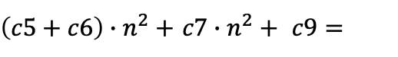
Running time analysis
Example 2: Searching a 2D array
// Checks if a 2D square array contains the given value
Boolean contains(int[][] arr, int x) {
int n = arr.length
for (int i = 0; i < n; i++) {
for (int j = 0 ; j < n ; j++) {
if (a[i][j] == x) {
return true;
}
return false;
}
RunningTime (n) =
$$c0+ c1+$$
c0
$\left(c2+c3\right)∙n+$ $c4∙n+$
c1
c2
c3
$\left(c5+c6\right)∙n^{2}+$ $c7∙n^{2}+ c9=$
c4
c5
c6
Assuming that each operation takes more or less the same time, c:
c7
c8
$$3c+3c∙n+3c∙n^{2}$$
Assumption: Each operation takes more or less the same time, c
c9
Observation: The term that grows fastest when n increases: $3c∙n^{2}$
Running time
Focus on the term that grows fastest as $n$ increases
Running time = order of magnitude of this term (ignoring all constants): O ( n² )
$$def$$

Slide 16
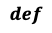
Running time analysis
Example 3: Parity
// Checks the parity of the given number
Boolean isEven(int n) {
return (n % 2) == 0;
}
Running time
Does not depend on the input size (n)
RunningTime (n) = O ( 1 )
$$def$$

Slide 17
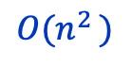
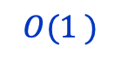
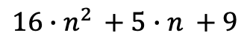

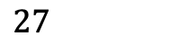
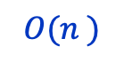
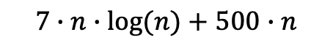
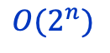

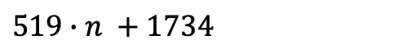
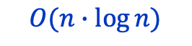
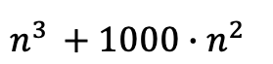
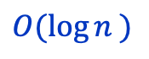
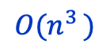
Running time functions
Examples
$$27$$
$$O(1^{ })$$
$$O(n^{ })$$
$${519∙n}^{ }+1734$$
$${16∙n}^{2 }+{5∙n}^{ }+9$$
$$O(n^{2 })$$
$$n^{3 }+{1000∙n^{2 }}^{ }$$
$$O(n^{3 })$$
Typical running-times, as
Functions of the input size, n
$$200∙log\left(n\right)+15$$
$$O({\log{n}}^{ })$$
$$7∙n∙log⁡(n)+500∙n$$
$$O(n∙\log{n})$$
$$2∙n^{10}+2^{n}$$
$$O(2^{n})$$

Slide 18
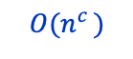
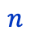
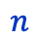
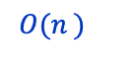
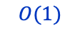
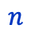
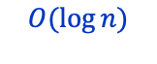
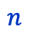
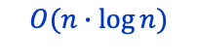
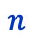
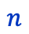
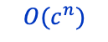
Running time functions
constant
$$O(n^{c })$$
$$O(1)$$
linear
$$O(n^{ })$$
polynomial
$$n$$
$$n$$
$$n$$
$$O(n∙\log{n})$$
$$O(c^{n})$$
logarithmic
$$O(\log{n})$$
log-linear
exponential
$$n$$
$$n$$
$$n$$

Slide 19
Running time analysis
Erasing element i from an ordered array with size = n elements:
2
4
4
6
7
8
8
9
size = 8
The algorithm’s input is an object consisting of three fields: arr, the array itself, maxSize, the fixed length of the array, and size, the number of elements that are presently in the array. Thus the actual input size is size.
In the example above the array is presently full: size = maxSize

Slide 20
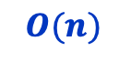
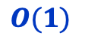
Running time analysis
Erasing element i from an ordered array with size = n elements:
Before:
2
4
4
6
7
8
8
9
size = n
After:
2
4
4
7
8
8
9
9
size = n – 1
RunningTime(n) =
Can we do better?
$$O(n)$$
Erasing element i from an unordered array with size = n elements:
Before:
4
2
1
7
3
2
5
2
size = n
After:
4
2
1
2
3
3
5
2
size = n – 1
RunningTime(n) =
$$O(1)$$

Slide 21
Lecture plan
Program efficiency
Search algorithms
Sequential search
Binary search
Sorting algorithms
Open computational problems

Slide 22
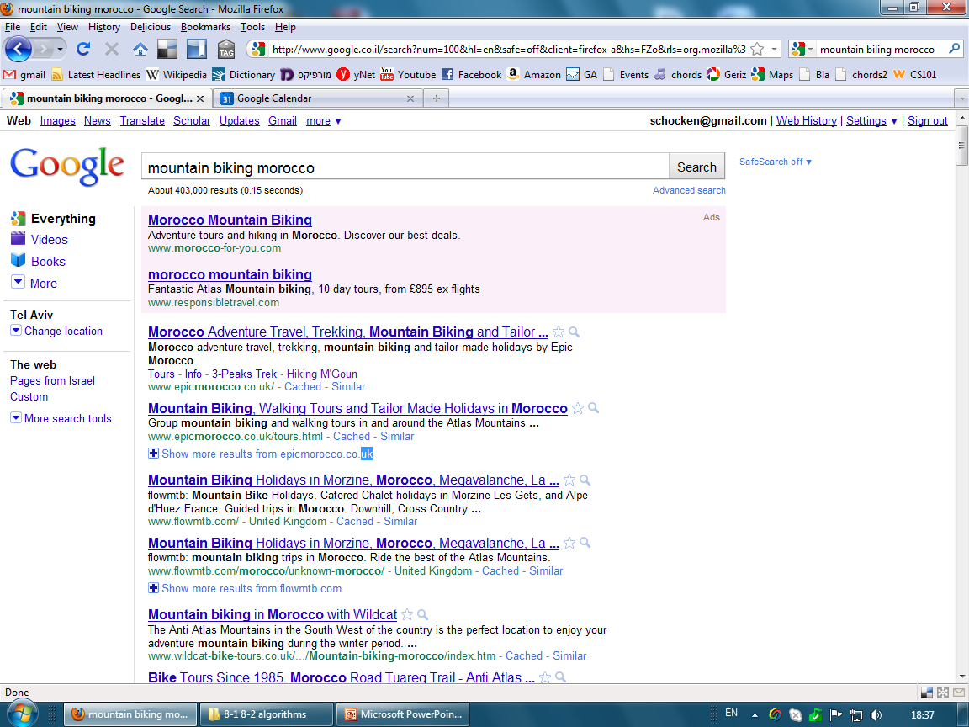
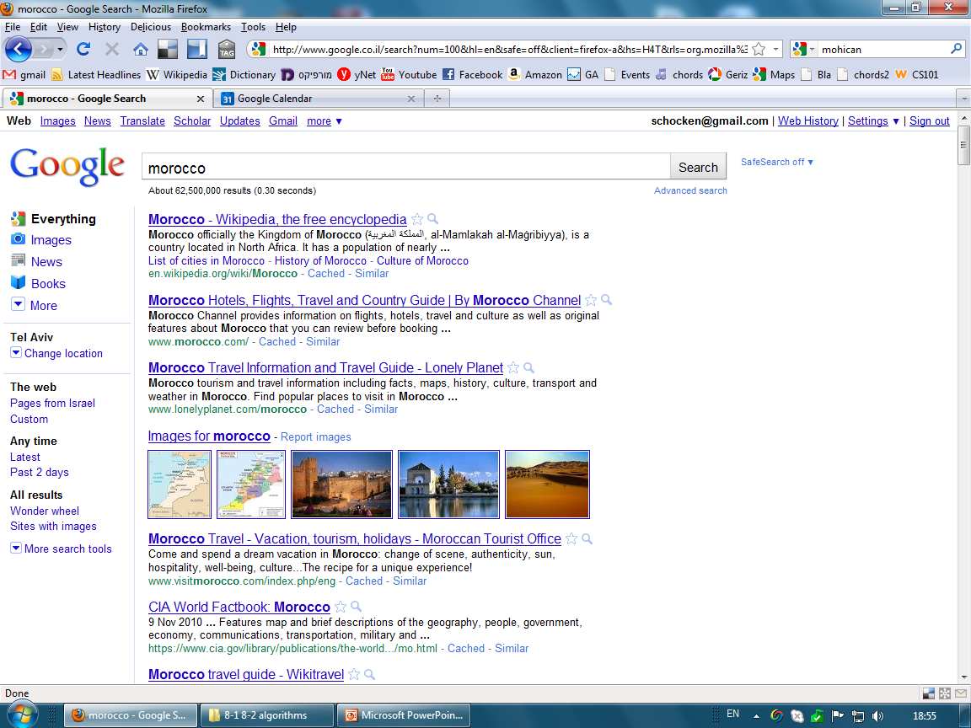
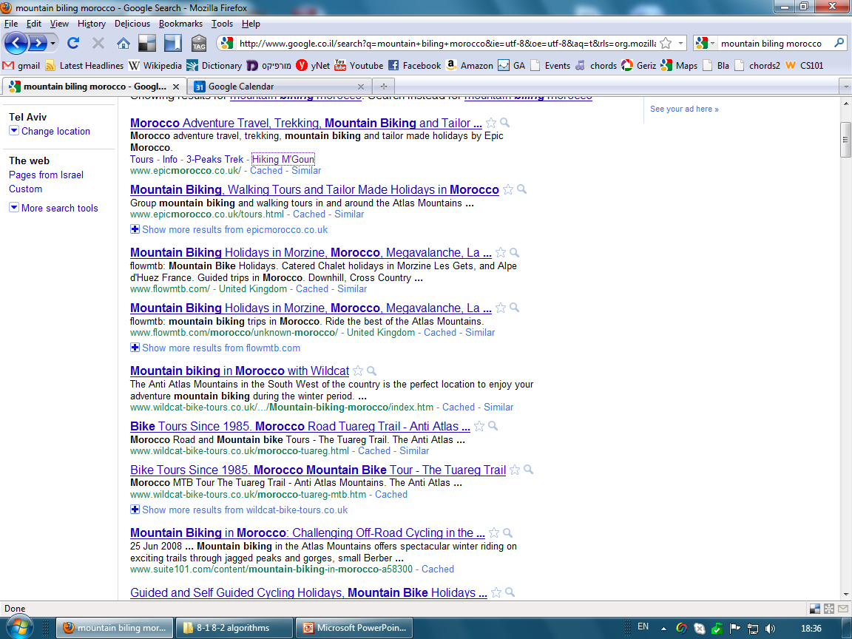

Context example: Search engine

Slide 23
Context example: Search engine
word
URLs
ninex
moize
morgan
namibia
mormon
morning
nancy
morocco
mortal
Mortgage
nalini
mountain
mohican
nader
name
never
nike
nitro
1955, 21
2, 11
13, 100,
95
1 ,7
4, 83
5, 17
12, 4
1, 7, 4, 5
17
5, 17
81, 9
11, 4, 5
10, 3, 5, 4
5, 11, 12,
5, 17
3, 51, 7,
1955, 21
The search engine’s data
A list of words,
each associated with the URLs of web pages that include it;
Stored on many servers and maintained continuously by hard-working robots.
... n words

Slide 24
Context example: Search engine
morocco
search
word
URLs
ninex
moize
morgan
namibia
mormon
morning
nancy
morocco
mortal
Mortgage
nalini
mountain
mohican
nader
name
never
nike
nitro
1955, 21
2, 11
13, 100,
95
1 ,7
4, 83
5, 17
12, 4
1, 7, 4, 5
17
5, 17
81, 9
11, 4, 5
10, 3, 5, 4
5, 11, 12,
5, 17
3, 51, 7,
1955, 21
Typical search scenario
User enters a word
The search engine searches the word in the list
Returns the URL’s, sorted by PageRank
Critical success factors:
Fast searching
Fast sorting.
... n words

Slide 25
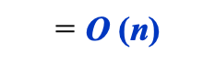
Sequential search
morocco
search
word
URLs
ninex
moize
morgan
namibia
mormon
morning
nancy
morocco
mortal
Mortgage
nalini
mountain
mohican
nader
name
never
nike
nitro
1955, 21
2, 11
13, 100,
95
1 ,7
4, 83
5, 17
12, 4
1, 7, 4, 5
17
5, 17
81, 9
11, 4, 5
10, 3, 5, 4
5, 11, 12,
5, 17
3, 51, 7,
1955, 21
Running time
$$\text{= }\text{O} \text{(}\text{n}\text{)}$$
... n words

Slide 26
Sequential search
// Returns the index of x in arr, or -1 if not found
public static int indexOf(int x, int[] arr) {
for (int i = 1; i < arr.length; i++) {
if (arr[i] == x) {
return i;
}
}
// Value not found
return -1;
}
0
1
1
3
4
5
6
7
8
9
97
51
72
83
20
7
9
15
91
2
arr
Worst case: x is not in arr
(similar to the contains method we saw earlier)
Running time
$$\text{= }\text{O} \text{(}\text{n}\text{)}$$
Can we do better?

Slide 27
Binary search
morocco
search
word
URLs
mohican
moize
morgan
mormon
morning
morocco
mortal
mortgage
mountain
nader
nalini
name
namibia
nancy
never
nike
ninex
nitro
11, 4, 5
2, 11
13, 100,
1 ,7
4, 83
12, 4
1, 7, 4, 5
17
81, 9
10, 3, 5, 4
9
5, 11, 12,
95
17, 2, 8
5, 17
3, 51, 7,
9, 1
1955, 21
The data is sorted
... n words

Slide 28
Binary search
morocco
search
word
URLs
mohican
moize
morgan
mormon
morning
morocco
mortal
mortgage
mountain
nader
nalini
name
namibia
nancy
never
nike
ninex
nitro
11, 4, 5
2, 11
13, 100,
1 ,7
4, 83
12, 4
1, 7, 4, 5
17
81, 9
10, 3, 5, 4
9
5, 11, 12,
95
17, 2, 8
5, 17
3, 51, 7,
9, 1
1955, 21
?
“morocco” <= “mountain”
1
The data is sorted
... n words

Slide 29
Binary search
morocco
search
word
URLs
mohican
moize
morgan
mormon
morning
morocco
mortal
mortgage
mountain
nader
nalini
name
namibia
nancy
never
nike
ninex
nitro
11, 4, 5
2, 11
13, 100,
1 ,7
4, 83
12, 4
1, 7, 4, 5
17
81, 9
10, 3, 5, 4
9
5, 11, 12,
95
17, 2, 8
5, 17
3, 51, 7,
9, 1
1955, 21
?
“morocco” <= “mormon”
2
?
“morocco” <= “mountain”
1
The data is sorted
... n words

Slide 30
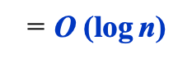
Binary search
morocco
search
word
URLs
mohican
moize
morgan
mormon
morning
morocco
mortal
mortgage
mountain
nader
nalini
name
namibia
nancy
never
nike
ninex
nitro
11, 4, 5
2, 11
13, 100,
1 ,7
4, 83
12, 4
1, 7, 4, 5
17
81, 9
10, 3, 5, 4
9
5, 11, 12,
95
17, 2, 8
5, 17
3, 51, 7,
9, 1
1955, 21
?
“morocco” <= “mormon”
2
?
“morocco” <= “morocco”
3
?
“morocco” <= “mountain”
1
In each iteration we divide the size of the search space by 2
How many times can we divide n by 2?
Running time
$$\text{= }\text{O} \text{(}\text{log} \text{n}\text{)}$$
The data is sorted
... n words

Slide 31
Binary search
// Returns the index of x in a sorted arr, or -1 if not found
// Precondition: arr must be sorted
public static int indexOf(int x, int[] arr) {
0
1
1
3
4
5
6
7
8
9
2
7
9
15
20
51
72
83
91
97
arr
Running time
$$\text{= }\text{O} \text{(}\text{log} \text{n}\text{)}$$

Slide 32
Binary search
// Returns the index of x in a sorted arr, or -1 if not found
// Precondition: arr must be sorted
public static int indexOf(int x, int[] arr) {
int low = 0;
int high = arr.length - 1;
while (low <= high) {
int med = (low + high) / 2;
if (arr[med] == x) {
return med;
}
if (x < arr[med]) {
high = med - 1;
} else {
low = med + 1;
}
}
// Value not found
return -1;
}
0
1
1
3
4
5
6
7
8
9
2
7
9
15
20
51
72
83
91
97
arr
Simulating indexOf(72, arr):
Iteration low high med arr[med] test
0 0 9 4 20 72 > 20 ?
1 5 9 7 83 72 < 83 ?
2 5 6 5 51 72 > 51 ?
3 6 6 6 72 72 = 72
Running time
$$\text{= }\text{O} \text{(}\text{log} \text{n}\text{)}$$

Slide 33
Binary vs sequential search
Seq. Binary
search search
running tine (worst case)
n
O(n)
O(log₂n)
O(n)
Input size:
RunningTime
8
8
3
16
16
4
sequential search
32
32
5
64
64
6
100
100
7
O(log n)
1,000
1,000
10
binary search
1,000,000
1,000,000
20
1,000,000,000
1,000,000,000
30
input size: n
Why is logarithmic running time attractive? Because log₂(2n) = log₂n + 1
Implications for search engines:
As the size of the Internet doubles, each search requires one more iteration.

Slide 34
Lecture plan
Program efficiency
Search algorithms
Sequential search
Binary search
Sorting algorithms
Selection sort
Insertion sort
Radix sort
Open computational problems

Slide 35
Sorting
Before:
13
10
7
3
15
1
4
11
After in-place sorting:
After:
1
3
4
7
10
11
13
15
There are many sorting algotithms, of which we’ll discuss three.

Slide 36
Selection sort
Analysis
step 0: we scan n elements
step 1: we scan n – 1 elements
step 2: we scan n – 2 elements
...
Total number of iterations =
n + (n – 1) + … + 1 = ½ n(n – 1) = ½ n² - ½ n
Running time = O (n²)
// Sorts an array of length n
for i = 0 .. n – 1
min = i
for k = i + 1 .. N
if (a[k] < a[min])
min = k
swap a[i], a[min]
(informal pseudo-code)
step 0:
13
10
7
3
15
1
4
11
Selection algorithm:
Find the minimum, swap with the next left-most element
step 1:
1
10
7
3
15
13
4
11
step 2:
1
3
7
10
15
13
4
11
step 3:
1
3
4
10
15
13
7
11
...
1
3
4
7
15
13
10
11

Slide 37
Insertion sort
// Sorts array of length n
for j = 1 .. n – 1
k = j – 1
while (a[k] > a[j] and k >= 0)
swap a[k + 1], a[k]
k--
Analysis
How many swaps we have to do in the worst case?
1 + 2 + 3 + … + n = ½ n(n + 1)
Running time = O (n²)
step 0:
10
2
14
5
4
18
3
7
Insertion algorithm:
Going from left to right:
For each element, swap with the element on the left, until the element reaches its place
step 1:
2
10
14
5
4
18
3
7
step 2:
2
10
14
5
4
18
3
7
step 3:
2
5
10
14
4
18
3
7
...
2
4
5
10
14
18
3
7

Slide 38
Simple sort algorithms
Selection sort
Insertion sort
Bubble sort
...
There are many other sorting algorithms, all based on pairwise comparisons
All O (n²) . . .
Can we do better?

Slide 39
Radix sort
Input: 230, 34, 76, 80, 735, 21, 4, 59
Set up: Create an array of 10 empty lists, one for each digit:
0: ( )
1: ( )
2: ( )
3: ( )
4: ( )
5: ( )
6: ( )
7: ( )
8: ( )
9: ( )

Slide 40
Radix sort
Input: 230, 34, 76, 80, 735, 21, 4, 59
Step 0: Add the values to the lists, according to their least significant (right-most) digit:
230, 34, 76, 80, 735, 21, 4, 59
0: (230, 80)
1: (21)
2: ( )
3: ( )
4: (34, 4)
5: (735)
6: (76)
7: ( )
8: ( )
9: (59)
Remove the values from the lists, preserving their order:
Output: 230, 80, 21, 34, 4, 735, 76, 59

Slide 41
Radix sort
Input: 230, 80, 21, 34, 4, 735, 76, 59
(Output of previous stage)
0: ( )
1: ( )
2: ( )
3: ( )
4: ( )
5: ( )
6: ( )
7: ( )
8: ( )
9: ( )

Slide 42
Radix sort
Input: 230, 80, 21, 34, 4, 735, 76, 59
(Output of previous stage)
Step 1: Add the values to the lists, according to their next right-most digit:
230, 080, 021, 034, 004, 735, 076, 059
0: (4)
1: ( )
2: (21)
3: (230, 34, 735)
4: ( )
5: (59)
6: ( )
7: (76)
8: (80)
9: ( )
Remove the values from the lists, preserving their order:
Output: 4, 21, 230, 34, 735, 59, 76, 80

Slide 43
Radix sort
Input: 4, 21, 230, 34, 735, 59, 76, 80
(Output of previous stage)
0: ( )
1: ( )
2: ( )
3: ( )
4: ( )
5: ( )
6: ( )
7: ( )
8: ( )
9: ( )

Slide 44
Radix sort
Input: 4, 21, 230, 34, 735, 59, 76, 80
(Output of previous stage)
Step 2: Add the values to the lists, according to their next right-most digit:
004, 021, 230, 034, 735, 059, 076, 080
0: (4, 21, 34, 59, 76, 80)
1: ( )
2: (230)
3: ( )
4: ( )
5: ( )
6: ( )
7: (735)
8: ( )
9: ( )
Time complexity:
RunningTime = O (k N)
where k is the number of digits of the maximal value
Space complexity:
Storing lists
Remove the values from the lists, preserving their order:
Output: 4, 21, 34, 59, 76, 80, 230, 735
sorted

Slide 45
Lecture plan
Program efficiency
Search algorithms
Sequential search
Binary search
Sorting algorithms
Selection sort
Insertion sort
Radix sort
Open computational problems

Slide 46
Open computational problems
node
edge
Input size: N (number of nodes)
Euler path: Is there a path that visits every edge exactly once?
There is a simple algorithm that answers this question in linear time: O (N)
Hamilton path: Is there a path that visits every node exactly once?
So far, the only algorithms that answer this question run in exponential time: O (2^{N} )

Slide 47
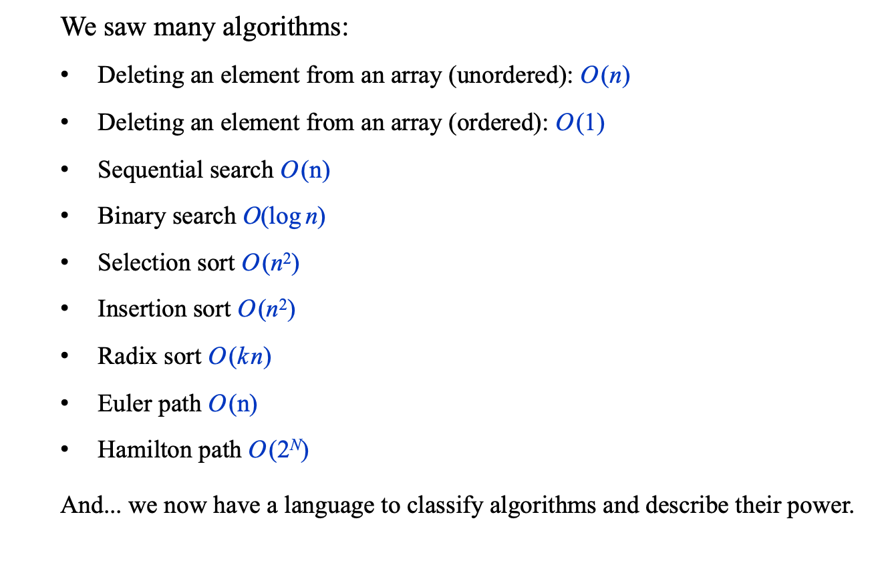
Recap
We saw many algorithms:
Deleting an element from an array (unordered): O (n)
Deleting an element from an array (ordered): O (1)
Sequential search O (n)
Binary search $\text{O}\text{(}\text{log} \text{n}\text{)}$
Selection sort O (n²)
Insertion sort O (n²)
Radix sort O (k n)
Euler path O (n)
Hamilton path O (2^{N})
And... we now have a language to classify algorithms and describe their power.

Slide 48
Common running time functions
simple sorting algorithms
Hamilton path
QuickSort,
MergeSort
sequential search
Radix sort
Euler path
Input size (N)
Binary search

Slide 49
Appendix: The Timer class
/** Represents a timer.
* Features methods for starting a timer and checking how much
* time elapsed (in milliseconds) since the timer was started. */
public class Timer {
// The time at which this timer started running
private long startTime;
/** Constructs a timer and sets it to the current time. */
public Timer() {
reset();
}
/** Resets this timer. */
public void reset() {
startTime = System.currentTimeMillis();
}
/** Returns how many milliseconds elapsed between
* the last reset of this timer and the current time. */
public double elapsedTime() {
return (System.currentTimeMillis() – startTime);
}
}
A Java function, returns the difference, in milliseconds, between the current time and midnight, January 1, 1970.

Slide 50
Introduction to Computer Science
Reichman University
Lecture 8-1
Efficiency, Searching, Sorting
Notes:
50

Slide 51
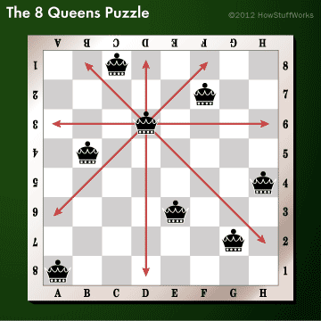

Exponential running time: Example
Eight-Queen problem:
Place 8 queens on a chessboard so that no queen threatens any other queen.
Possible configuration

Slide 52
Exponential running time: Example
Eight-Queen problem:
Place 8 queens on a chessboard so that no queen threatens any other queen.
Possible configuration
Notation:
Queen Q_{i} is located in row i
Configuration: <columnQ₁, columnQ₂, …, columnQ₈ >
Configuration shown above: <3, 6, 4, 2, 8, 5, 7, 1>
Possible algorithm
// Prints all the solutions of the n-queen problem
void q8Solver(int n) {

Slide 53
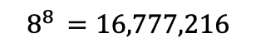
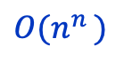
Exponential running time: Example
Eight-Queen problem:
Place 8 queens on a chessboard so that no queen threatens any other queen.
Possible configuration
Comments
The strategy of generating and checking many configurations is called brute force
No better solution is known for the general n-queen problem
When n = 8, we can use various rules to considerably reduce the number of configurations that should be checked, and find all the solutions in polynomial time (a few nested loops).
Notation:
Queen Q_{i} is located in row i
Configuration: <columnQ₁, columnQ₂, …, columnQ₈ >
Configuration shown above: <3, 6, 4, 2, 8, 5, 7, 1>
Possible algorithm
All configurations:
// Prints all the solutions of the n-queen problem
void q8Solver(int n) {
while (there are unchecked configurations) {
Configuration c = new Configuration();
if (c.isValid()) {
print(c);
}
}
(1, 1, 1, 1, 1, 1, 1, 1)
(1, 1, 1, 1, 1, 1, 1, 2)
…
(1, 1, 1, 1, 1, 1, 1, 8)
(2, 2, 2, 2, 2, 2, 2, 1)
(2, 2, 2, 2, 2, 2, 2, 2)
…
(2, 2, 2, 2, 2, 2, 2, 8)
…
(8, 8, 8, 8, 8, 8, 8, 8)
$$8^{8 }=16,777,216$$
configurations, of which 92 are valid (solutions)
RunningTime =
$$O(n^{n })$$

Slide 54
Timing program’s efficiency
/** Times the performance of my computer. */
public class TimeMyComputer {
public static void main(String args[]) {
int sum = 0;
double d = 1.618;
BankAccount bobAcct = new BankAccount("bob");
// Starts a timer
Timer timer = new Timer();
for (int i = 0 ; i < 1000000000 ; i++) {
/// Uncomment the operation you wish to time:
/// Do nothing
/// sum = sum + i;
/// d = 1.0 / d;
/// bobAcct.deposit(i);
/// BankAccount b = new BankAccount("Bla",i);
/// Fraction f = new Fraction(i,i+1);
/// d = Math.random();
/// System.out.println(i);
}
// The loop’s running time, in milliseconds
System.out.println("Duration in ms: " + timer.elapsedTime());
}
}
Timer: A class for time measurements

Slide 55
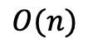
Worst / best / average case
// Checks if the given array contains the given value
boolean contains(int[] a, int x) {
for (int i = 0; i < a.length; i++) {
if (a[i] == x) {
return true;
}
return false;
}
}
Input size:
n, the length of the array
Average Case
x is element 0:
x is element 1:
…
x is element n:
Number of iterations:
1 iteration
2 iterations
…
n iterations
AverageNumberOfIterations(n) =
$$\left(1+2+…+n\right)∙\frac{1}{n} =\frac{1}{2} n∙\left(n+1\right)∙\frac{1}{n} = \frac{1}{2}∙\left(n+1\right)$$
AverageRunningTime(n) =
$$O(n)$$

Slide 56
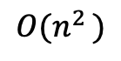
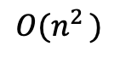
Quadratic running time: Example
// Checks if array arr1 is a subset of array arr2
boolean isSubsetOf(arr1, arr2) {
for (int x : arr1) {
// checks if x is in arr2
boolean found = false;
for (int y : arr2) {
if (x == y) {
found = true;
break; // No need to search further
}
}
// If x is not in arr2, arr1 can't be a subset
if (!found) {
return false;
}
}
}
Worst-case analysis
Outer loop executes arr1.length times;
For each outer iteration: Inner loop executes arr2.length times;
Running time is O (arr1.length * arr2.length)
Worst case occurs when the two arrays have the same length, and every element of arr1 is an element of arr2
Input size = n, the size of the larger array
RunningTime =
$$O(n^{2 })$$
Quadratic running time:
Special case of polynomial running time
Typically happens when the algorithm is based on nested loops
Running time = O (range of the outer loop ⨉ range of the inner loop)
$$O(n^{2 })$$

Slide 57



Running times: Recap
The bad news:
Many important problems are “intractable”, meaning that no better algorithms than brute force are known for them
$$2^{n }$$
The good news:
Many important problems can be solved efficiently by algorithms that have polynomial running times
$$n^{2 }$$
When a problem is intractable, we can …
Solve reduced versions of it
Use heuristics to find sub-optimal solutions which are “good enough”
“Artificial Intelligence”
“Machine Learning”
Greedy algorithms

Slide 58
Running times: Recap
constant
$$O(n^{c })$$
$$O(1)$$
linear
$$O(n^{ })$$
polynomial
$$n$$
$$n$$
$$n$$
$$O(n∙\log{n})$$
$$O(c^{n})$$
logarithmic
$$O(\log{n})$$
log-linear
exponential
$$n$$
$$n$$
$$n$$
next lecture

Slide 59
Bla
Graph size: N (number of nodes)
Euler path problem: Is there a path that visits every edge exactly once?
The best algorithm that answers the question runs in linear time: O(N)
Hamilton path problem: Is there a path that visits every node exactly once?
The best algorithm that answers the question runs in exponential time: O(2^{N})

Slide 60


Constant and Linear running times: Examples
Erasing element i from an ordered array of n elements:
Before:
2
4
4
6
7
8
8
9
After:
2
4
4
7
8
8
9
9
RunningTime(n) =
$$O(n)$$
Erasing element i from an ordered list of n elements:
a
2
4
4
6
7
8
8
9
a
2
4
4
6
7
8
8
9
RunningTime(n) =
$$O(1)$$

Slide 61

Lecture plan
Program efficiency
Search algorithms
Sequential sort O(n)
Binary sort $\text{O}\text{(}\text{log} \text{n}\text{)}$
Sorting algorithms
Selection sort O(n²)
Insertion sort O(n²)
Radix sort O(k n)
Open CS challenges

Slide 62
Introduction to Computer Science
Reichman University
Lecture 9-2
Efficiency, Searching, Sorting
Notes:
62

